Slide 3
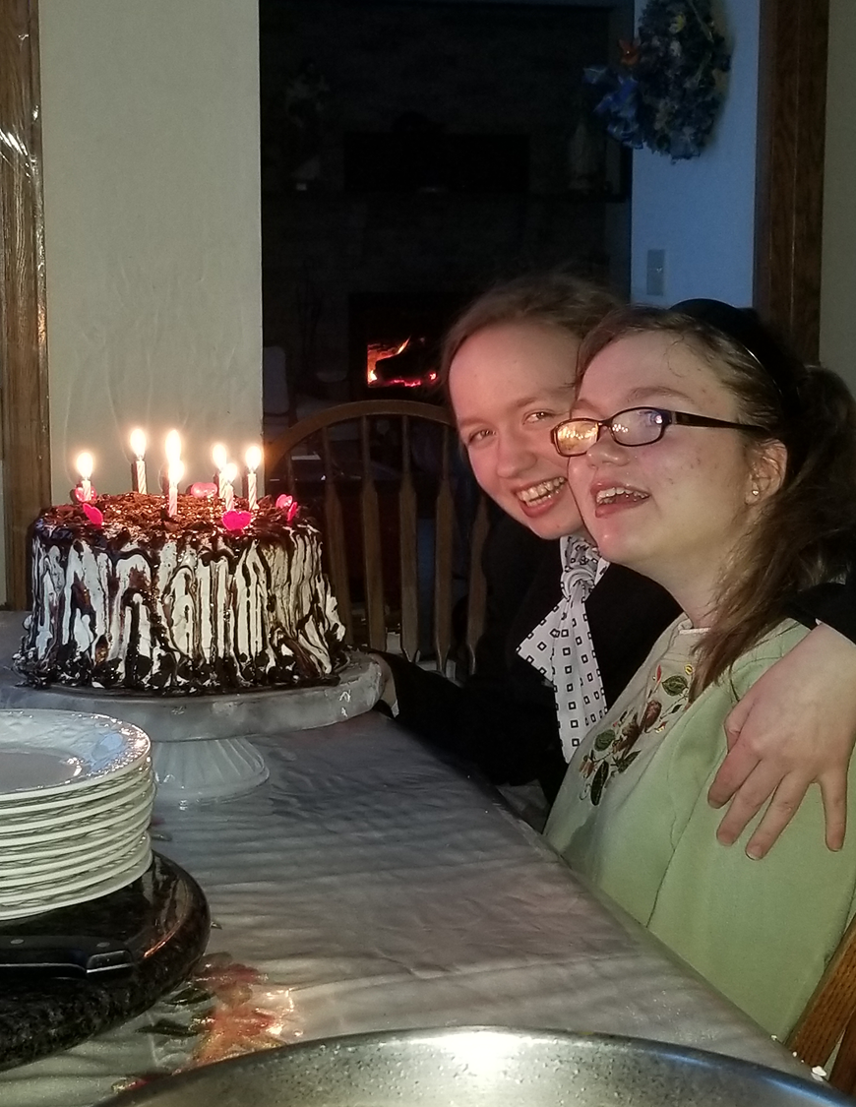
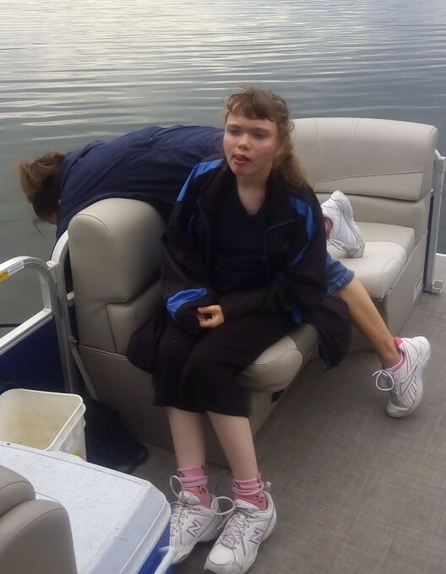
Catherine’s Story
Born 6 weeks premature
7 isolated cases of seizures
Suppose to be in the bottom 10% of head, hand and feet size
Went to John Hopkins to be part of a National Rett Study
Found out that we truly have a Shaklee miracle with Catherine.
************
On no medications
No seizures in the past 10 years.
In the normal growth range in size
As a girl with Rett Syndrome, she is suppose to be in a wheel chair- she walks!
Her incredible physical ability, thanks to Shaklee, is Priceless!

Slide 9
Sugar and the Immune System

Slide 49
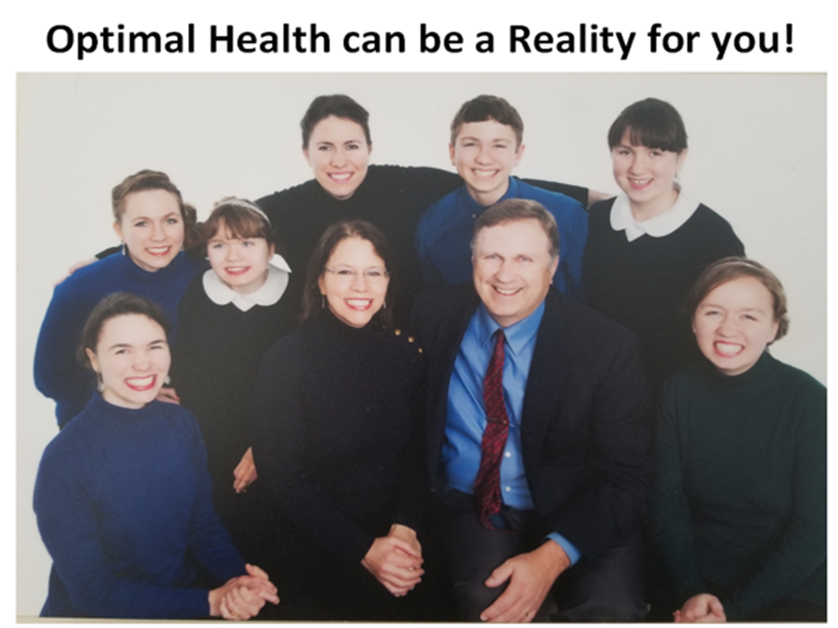

Slide 50
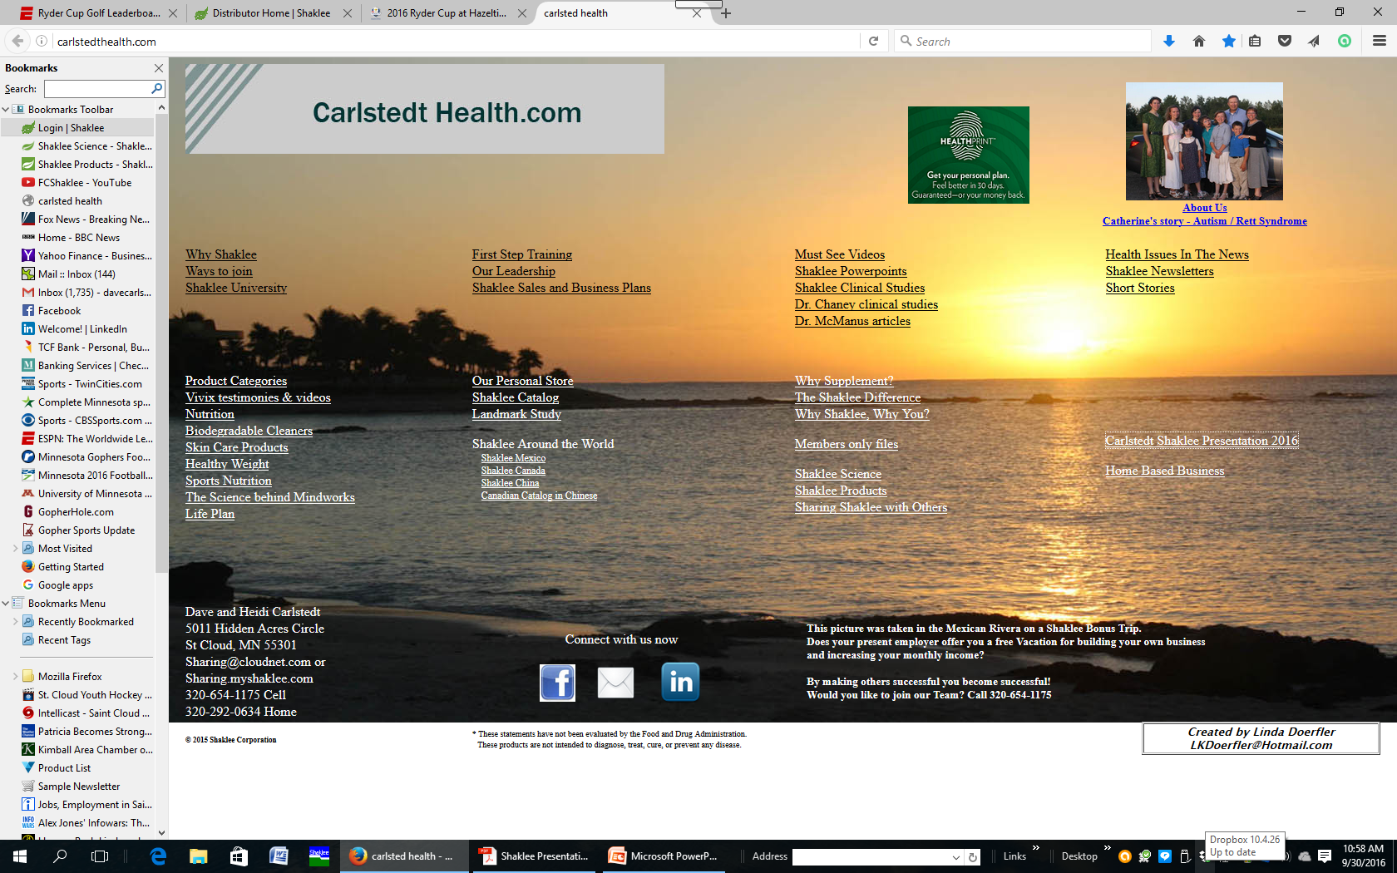

Slide 53
